Slide 1
Excel assessment

Slide 2
Q1. data cleaning
Selected whole data and clicked remove duplicates to remove all duplicates from sheet.
No empty cells are present

Slide 3
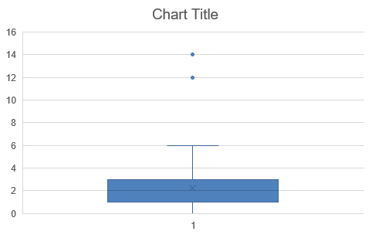
Q2. box plot created to show that all the videos that got into trending was done in a gap of 1 to 3days
But only 2 videos took 12 and 14 days after publishing date to get into trending
Formulas used are trending date-publishing date -- B2:B593-F2:F593
Average time gap is 2.2

Slide 4
Q3. based on the line chart we can infer that
Autos and vehicles got higher average of views compared to others
Entertainment got higher sum of likes than others
Entertainment got higher count of comments than others
So, entertainment is doing well in terms of views and engagement

Slide 5
Q4. Formulas used were
XLOOKUP(W9,Category!A:A,Category!B:B,"no",0)
FILTER(A:A,E:E=W9,"no")
FILTER(A:A,D:D=W6,"no")

Slide 6
Q5. formulas used
CONCAT(C2,D2)
TEXTJOIN(",",TRUE,FILTER(P:P,T:T=T2))

Slide 7
Q6. only comments disabled videos are there in the data and their count of comments is 592

Slide 8
Q7. line chart created for sum of views, sum of likes and count of comments for each channel title.

Slide 9
Q8. top 5 videos in each category are marked with yellow
bottom 5 videos in each category are marked with pink

Slide 10
Q9. bar chart for publish date, views and comments
2018 jan has more sum of views of videos published in that time

Slide 11
Q10. Sum of views increased 62% from 2017 to 2018
Likes and comments also increased over period

Slide 12
Q11. retention rate increased about 39% from 2017 to 2018

Slide 13
Q13. category id of 24 got higher comments than others that is entertainment category

